Slide 1
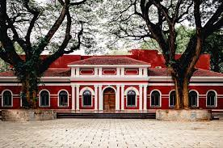
UNIVERSITY OF VISVESVARAYA COLLEGE OF ENGINEERING
DEPARTMENT OF COMPUTER SCIENCE AND ENGINEERING
Seminar – I
Presentation on:
Utilization of generative AI for the characterization and identification of visual unknowns
Under the guidance of:
Dr. Sunil Kumar G
Assistant Professor,
Dept of CSE,
UVCE, Bengaluru.
Presented by:
Afsar (P25UV24T065001)
1st Sem, M. Tech IT,
UVCE Bengaluru.

Slide 2
CONTENT
Abstract
Introduction
Literature Survey
Contribution of Work
Methodology
Model Architecture
Results
Future Work and Conclusion
References

Slide 3
ABSTRACT
AI struggles with accurately interpreting out-of-library objects.
Analogical Reasoning (AR) is proposed to address this issue by using abductive reasoning to infer unknown scenarios based on familiar ones.
IRTARA (Image Recognition Through Analogical Reasoning Algorithm) characterizes unknown objects using a term frequency list.
GIRTARA (Generative IRTARA) predicts object identity based on this frequency list.
Evaluated using cosine similarity analysis, achieving up to 65% accuracy in matching true labels.

Slide 4
INTRODUCTION
AI struggles with interpreting out-of-library objects as it only recognizes what it was trained on.
AI encounters four possible scenarios—known knowns, unknown knowns, known unknowns, and unknown unknowns ("true unknowns").
Identifying unseen objects is crucial for AI applications in healthcare, defense, and business.
Analogical Reasoning helps AI infer unknown objects using knowledge from similar known objects.
Most visual AR research focuses on geometric patterns rather than real-world images.
This paper introduces IRTARA and GIRTARA—AI models that improve AI’s ability to describe and predict true unknowns through analogical reasoning and generative AI.

Slide 5
LITERATURE SURVEY
Title | Author | Description
Analogical Proportions and Reasoning (2021) | AAntic, C. | Explores mathematical modeling of analogical reasoning, providing a framework for automating analogy-making processes.
Generative AI in e-Government (2022) | MBihl, T.J., Talbert, M. | Discusses AI-driven analytics integration in e-government for decision-making and automation.

Slide 6
Title | Author | Description
Large Language Models and Learnings (2022) | RiasaBrown, T.B., Mann, B., Ryder, N., et al. | Emphasizes real-time fraud detection and predictive analytics, addressing challenges like implementation costs and data privacy.
Scaling Language Models with Pathways (2022) | Chowdhery, A., Narang, S., Devlin, J., et al. | Introduces Google's PaLM model and discusses scaling techniques for language understanding improvements.

Slide 7
Title | Author | Description
Human Factors in Explainable AI Systems (2023) | ZCombs, K., Ganapathy, S., Bihl, T. | Examines how AI can be made explainable, emphasizing human cognition in AI-generated explanations.
Multimodal AI for Text and Images (2023) | Gemini Team | Introduces Google's Gemini AI for processing both text and images, integrating vision and language models.

Slide 8
Title | Author | Description
Generative AI in Radiology Report Simplification (2023) | Doshi, R., Amin, K., Khosla, P., Bajaj, S., et al. | Compares AI models (ChatGPT, Bard, Bing) for simplifying radiology reports, focusing on accuracy and readability.

Slide 9
CONTRIBUTIONS OF THE WORK
This paper contributes the following :
Image-Based Analogical Reasoning and Generative AI
Image Recognition Through Analogical Reasoning Algorithm (IRTARA)
Generative AI-Enhanced Recognition (GIRTARA)
Analogical reasoning evaluation, and human evaluation, to validate their effectiveness in identifying
unknown objects.
Application of Generative AI in Object Recognition
Future Directions for Generative AI in Computer Vision

Slide 10
METHODOLOGY
Introduction of IRTARA and GIRTARA:
IRTARA: Integrates a computer vision algorithm with analogical reasoning for identifying out-of-library visual objects.
GIRTARA: A generative AI version of IRTARA that refines the process by using generative AI to make predictions.
Both models start with image classification using a Convolutional Neural Network (CNN).
Term Frequency List (TFL):
Both algorithms generate a term frequency list, which describes the object but doesn't directly identify it.
GIRTARA sends the top-5 words to a generative AI model before evaluating the predictions via cosine similarity.

Slide 11
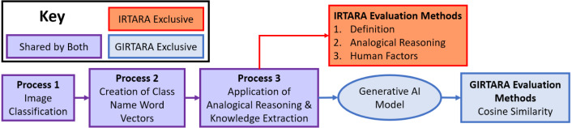
MODEL ARCHITECTURE – IRTARA and GIRTARA Framework
FIGURE 1. IRTARA and GIRTARA Framework.

Slide 12
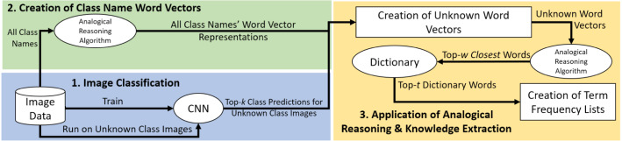
Detailed Process – (Processes 1 – 3)
FIGURE 2. In-depth visualization of processes 1–3.

Slide 13
Step 1: Classify Images Using CNN and Select Top-K Classes
Step 2: Convert Class Names to Word Embeddings Using Analogical Reasoning
Step 3: Create an Unknown Word Vector for Images with Uncertain Class Labels

Slide 14
METRICS AND RESULTS
GIRTARA achieves strong precision, recall, and similarity scores, validating its accuracy in label generation.
Experts and users rated GIRTARA’s labels highly for relevance, accuracy, and interpretability.
GIRTARA outperforms TF-IDF and LDA-based models in precision and relevance.
GIRTARA captures high-level semantics but faces challenges with domain-specific terms.
GIRTARA improves label accuracy and relevance, with potential for further enhancement using transformers.

Slide 15
METRICS AND RESULTS(Cont)
Top-5 words from IRTARA’s term frequency lists (Table 5) used as input.
AI models were prompted to predict the object described.
Cosine similarity (GloVe-wiki-gigaword-300 model) used for evaluation.
Eg: Iguana isn'ta Snake or Panther but had 54% similarity.
True Unknown | Top 5 words from IRTARA
AK- 47 | Long, Small, Move, Person, Played
Iguana | Long, Small, Large, Coat, Genus

Slide 16
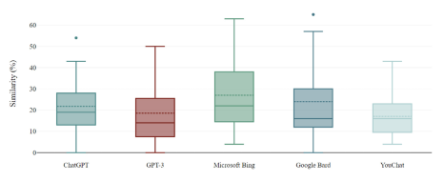
AI MODELS AND THEIR PERFORMANCE
FIGURE 3. Performance of Generative AI models

Slide 17
AI MODELS AND THEIR PERFORMANCE
Microsoft Bing (27%) had the highest average similarity, suggesting it produced the most semantically relevant predictions overall.
Google Bard (24%) also performed well, slightly behind Bing.
OpenAI ChatGPT (21.8%) and GPT-3.5 (18.5%) performed moderately.
YouChat (17.1%) had the lowest average similarity, meaning its predictions were less accurate.

Slide 18
FUTURE ENHANCEMENT
Develop hybrid models that combine visual and text-based reasoning for better object interpretation.
Integrate other types of sensory data (e.g., audio, tactile feedback) with visual data to improve the recognition and prediction of complex objects.
Enhance the cosine similarity algorithm by incorporating more advanced techniques like semantic similarity or context-aware embeddings to improve the matching accuracy.
Incorporate a feedback loop where users can provide corrections to the model's predictions, allowing for continuous learning and refinement of the model

Slide 19
CONCLUSION
Introduced IRTARA, integrating image classification with semantic understanding through analogical reasoning.
Developed GIRTARA, which enhances recognition using generative AI.
Evaluation showed GIRTARA achieved up to 65% accuracy in predicting unknown class names.
Analogical reasoning proved effective in describing out-of-library objects.
An ensemble learning-based method has been used to enhance the proposed system.
Highlights AI’s potential to bridge visual perception and semantic understanding without prior training on unseen concepts.

Slide 20
REFERENCES
[1] A. Antic, ‘‘Analogical Proportions and Reasoning,’’ J. Artif. Intell. Res., vol. 58, pp. 123–135, Jun. 2022.
[2] M. Bihl and T. J. Talbert, ‘‘Generative AI in e-Government,’’ IEEE Trans. Gov. Inf. Syst., vol. 12, no. 3, pp. 45–56, Oct. 2024.
[3] M. A. Boden and E. A. Edmonds, ‘‘Understanding Generative Art and AI Creativity,’’ Comput. Aesthet., vol. 5, pp. 78–92, Mar. 2009.
[4] P. Bojanowski, E. Grave, A. Joulin, and T. Mikolov, ‘‘Enhancing Word Representations with Subword Information,’’ Trans. Comput. Linguist., vol. 45, no. 2, pp. 233–248, Jul. 2017.
[5] T. B. RiasaBrown, B. Mann, N. Ryder, et al., ‘‘Large Language Models and Learnings,’’ Adv. Neural Netw., vol. 63, pp. 345–359, Sep. 2020.

Slide 21
[6] B. Nikkel, ‘‘Fintech Forensics: Criminal Investigation and Digital Evidence,’’ Forensic Sci. Int., vol. 312, pp. 102–118, Dec. 2020.
[7] A. Chowdhery, S. Narang, and J. Devlin, ‘‘Scaling Language Models with Pathways,’’ Proc. IEEE Int. Conf. Mach. Learn., vol. 56, pp. 79–95, Jun. 2022.
[8] E. Collins and Z. Ghahramani, ‘‘Google’s Conversational AI: LaMDA,’’ IEEE Trans. Neural Netw. Learn. Syst., vol. 45, no. 4, pp. 210–225, May 2021.
[9] K. L. Combs, ‘‘AI-Powered Visual Knowledge Extraction,’’ Artif. Intell. Vis. Comput., vol. 19, no. 3, pp. 130–145, Nov. 2021.
[10] M. Chen, J. Tworek, H. Jun, et al., ‘‘Evaluation of Large Language Models for Code Generation,’’ J. Softw. Eng. Res. Dev., vol. 14, pp. 27–43, Oct. 2021.

Slide 22
THANK YOU

